Slide 1
Agent Technology Lecture 04
AI Planning

Slide 2


Slide 3
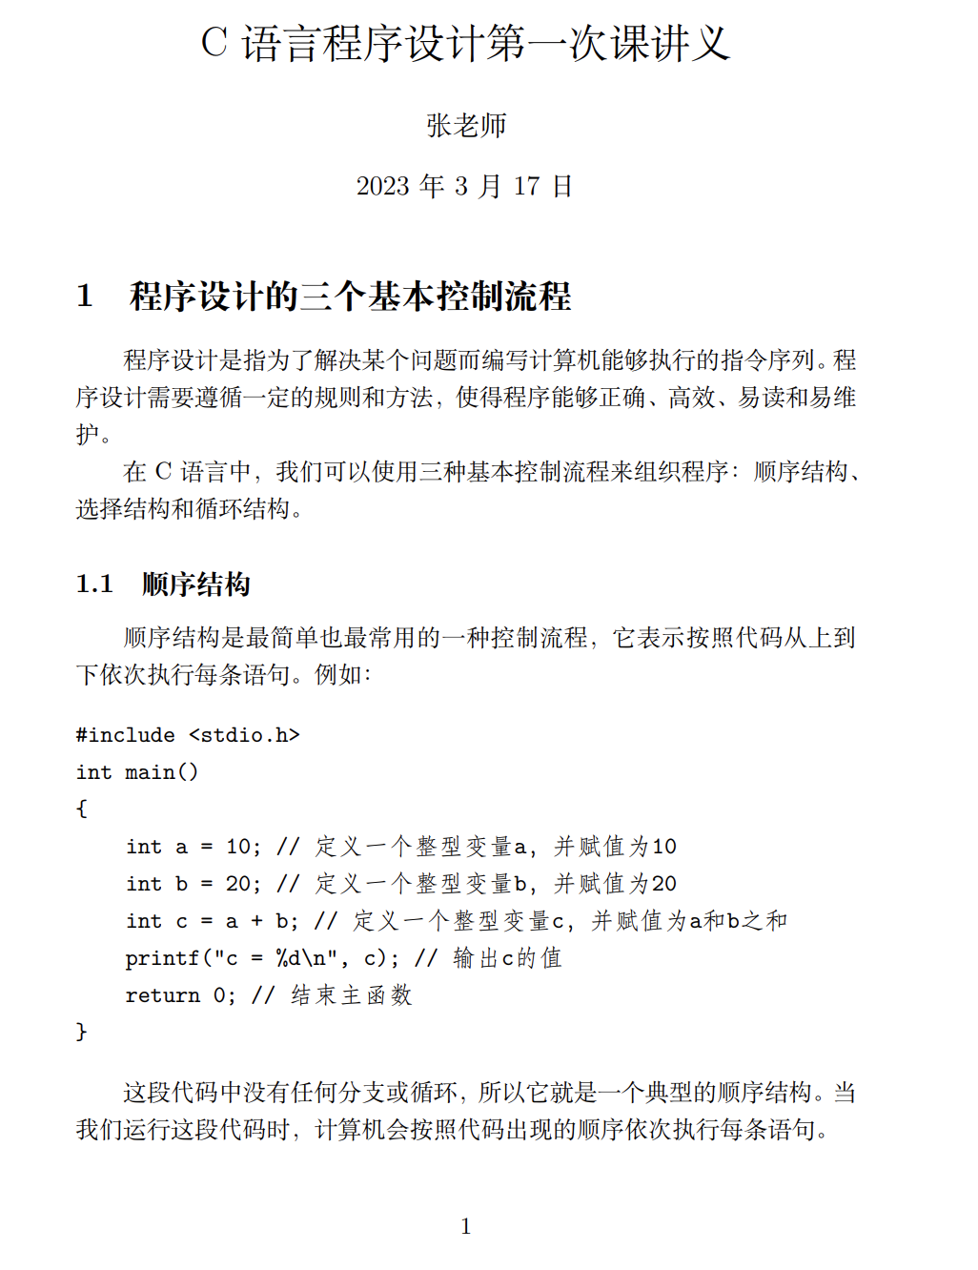
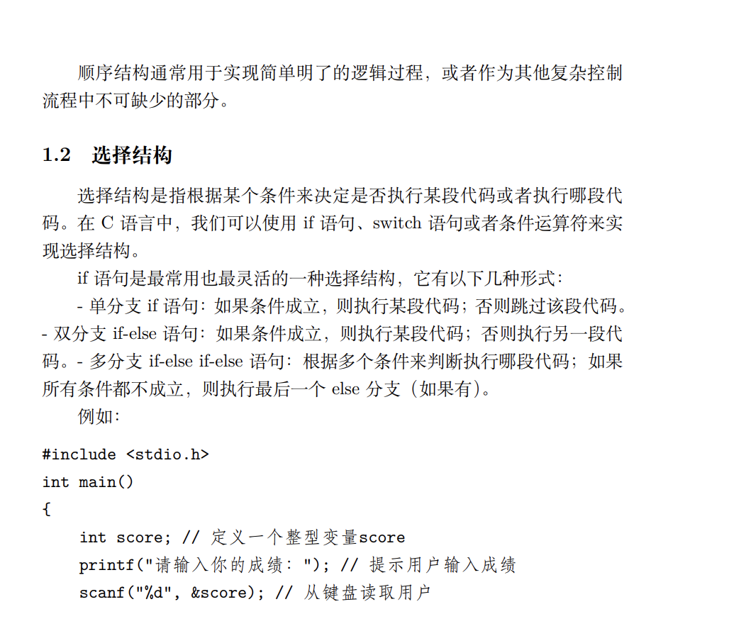

Slide 4
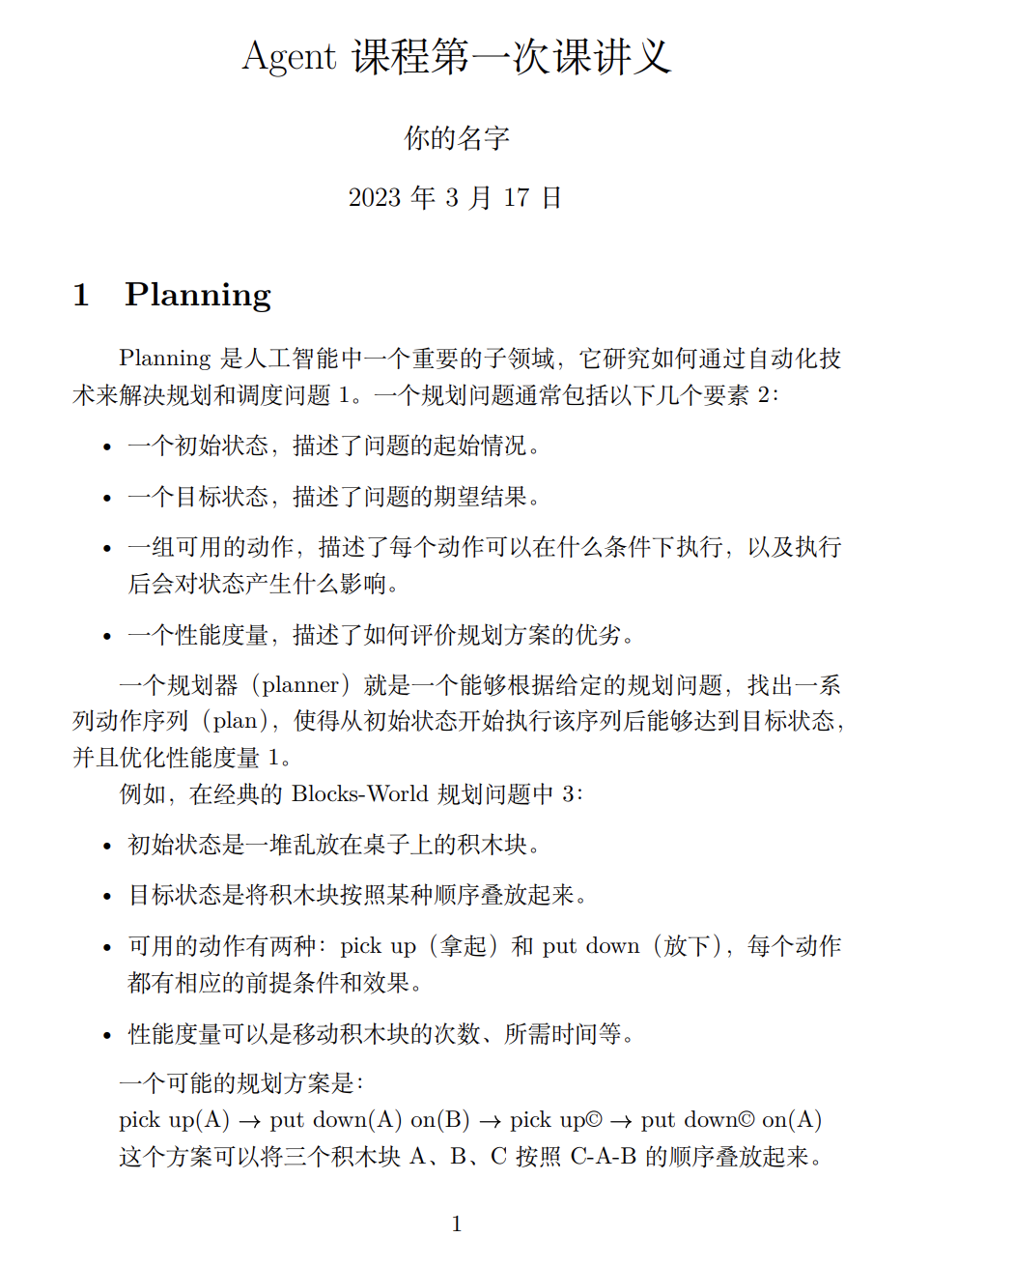
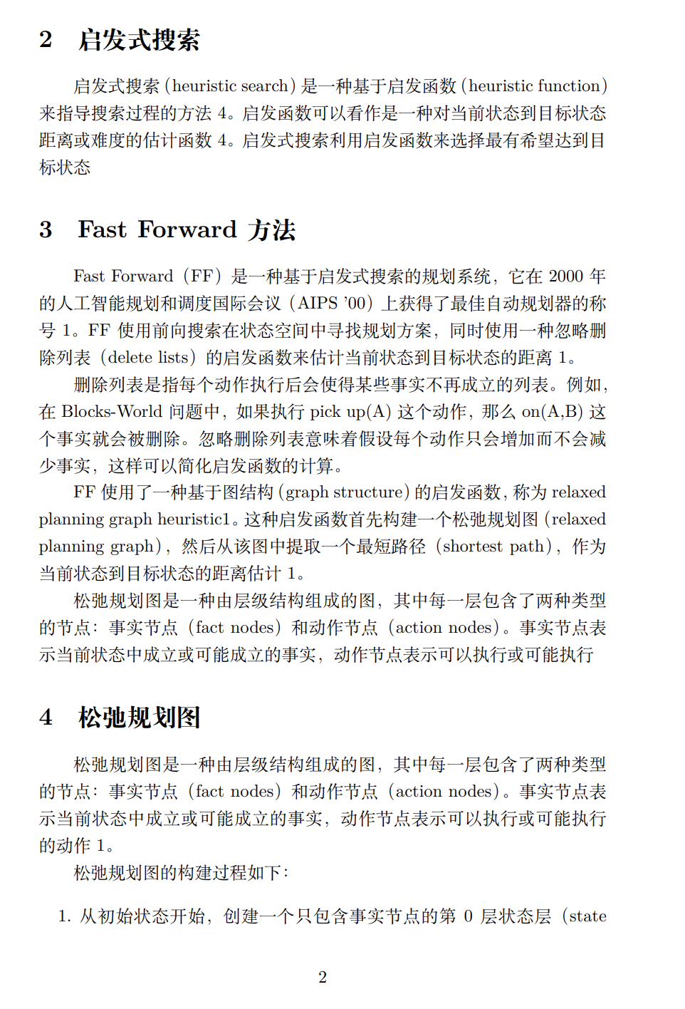

Slide 5
Model-based vs. Data-driven planning
Model-based Approaches
Know the inner workings of the world & do a form of causal reasoning (via search) to find a plan
Require less computation
Taskable
Verifiable
Transparent, Explainable
Good in environments where you cannot “explore” and you don’t have data or a simulator
but
You may not have the models
Where do they come from?
Are they accurate?
Models are “models” – approximations of the real world
If you have reasonable models, consider using/leveraging them in some way

Slide 6
Model-based vs. Data-driven planning
Data-driven Approaches
Rely on data to construct a plan/policy. E.g.,
Model-based Reinforcement Learning (RL)
Model-free RL
Perhaps learning a model or a reward function along the way
No reliance on inaccurate models – just use data
but
Not generally taskable – maximizing expected cumulative reward
Can be difficult to transfer
Not generally transparent, explainable
Can require a lot of data
Harder to verify for safety or other properties
Must have a simulator (a model!) or experiment in the environment (which could be unsafe or time consuming)

Slide 7
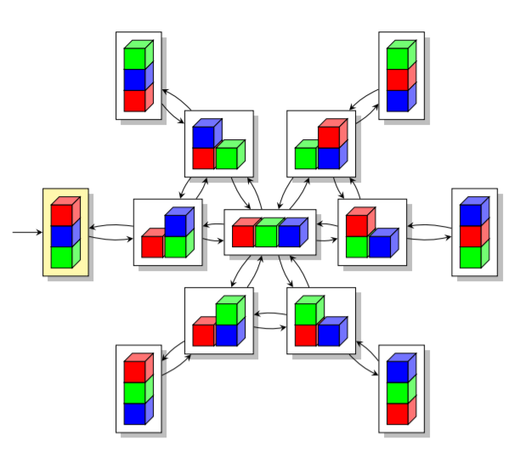
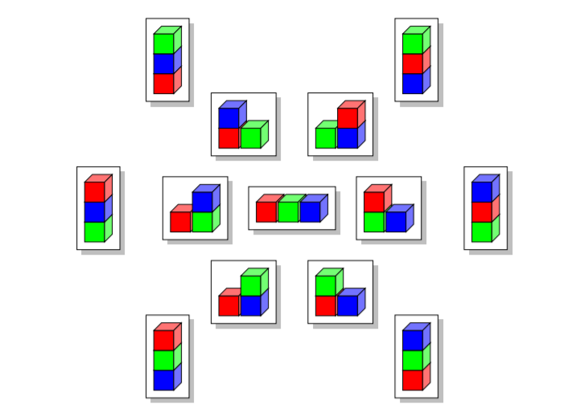
Classical planning
Reduces to the following problem:
Given (S, s0, G)
Find a sequence of actions (a1, a2, ... an) that produces a sequence of state transitions (s1, s2, ..., sn) such that G is in sn.
This is just path-searching in a graph
Nodes = states
Edges = actions
Blocks World

Slide 8
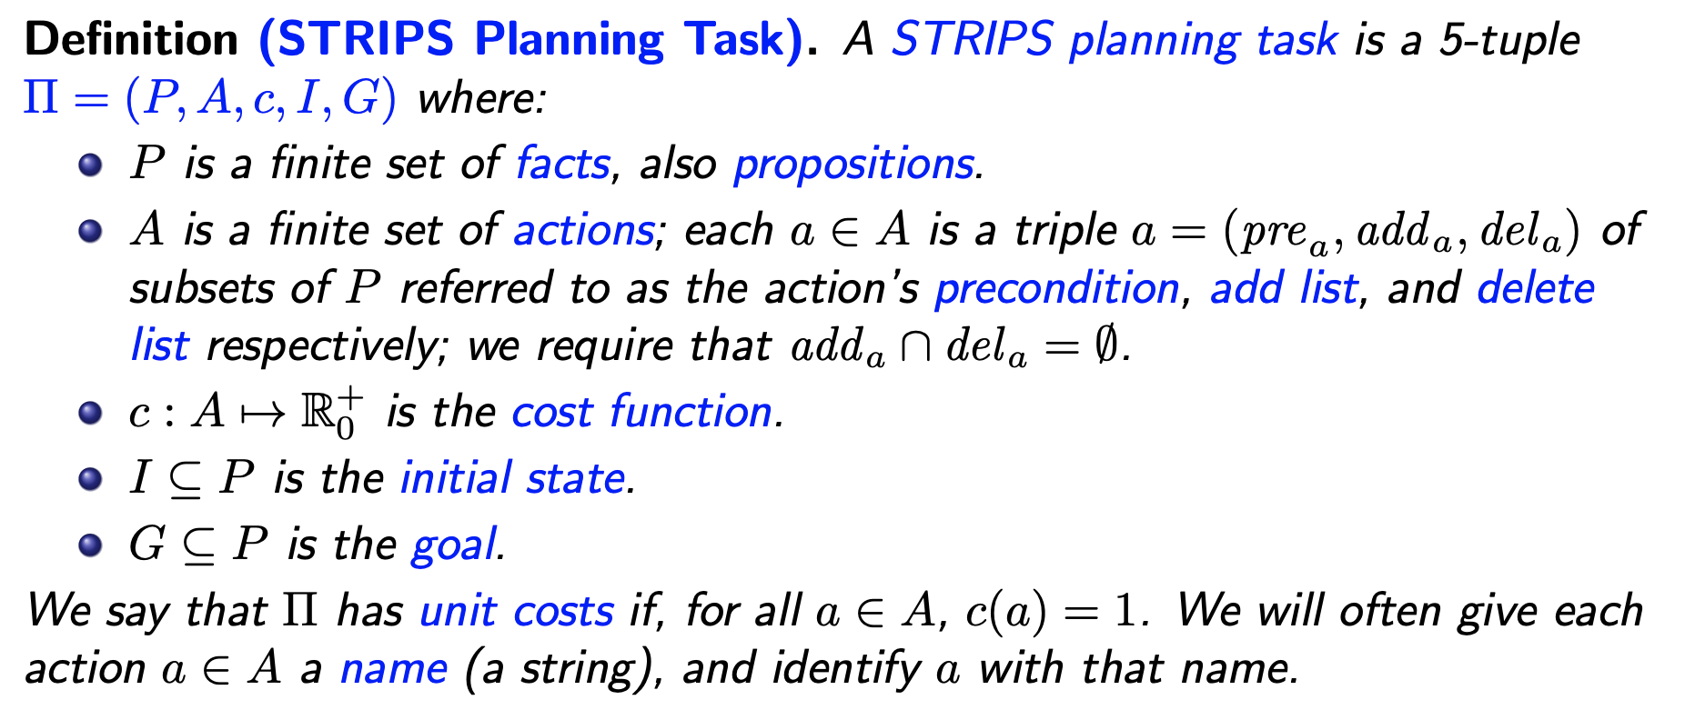
STRIPS Planning: Syntax

Slide 9
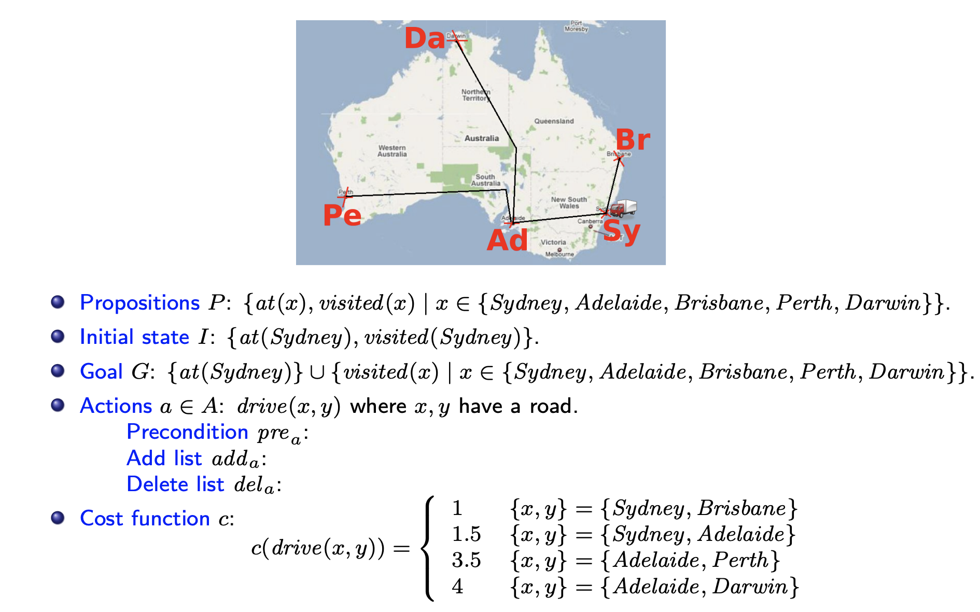
STRIPS Encoding of “TSP” in Australia

Slide 10
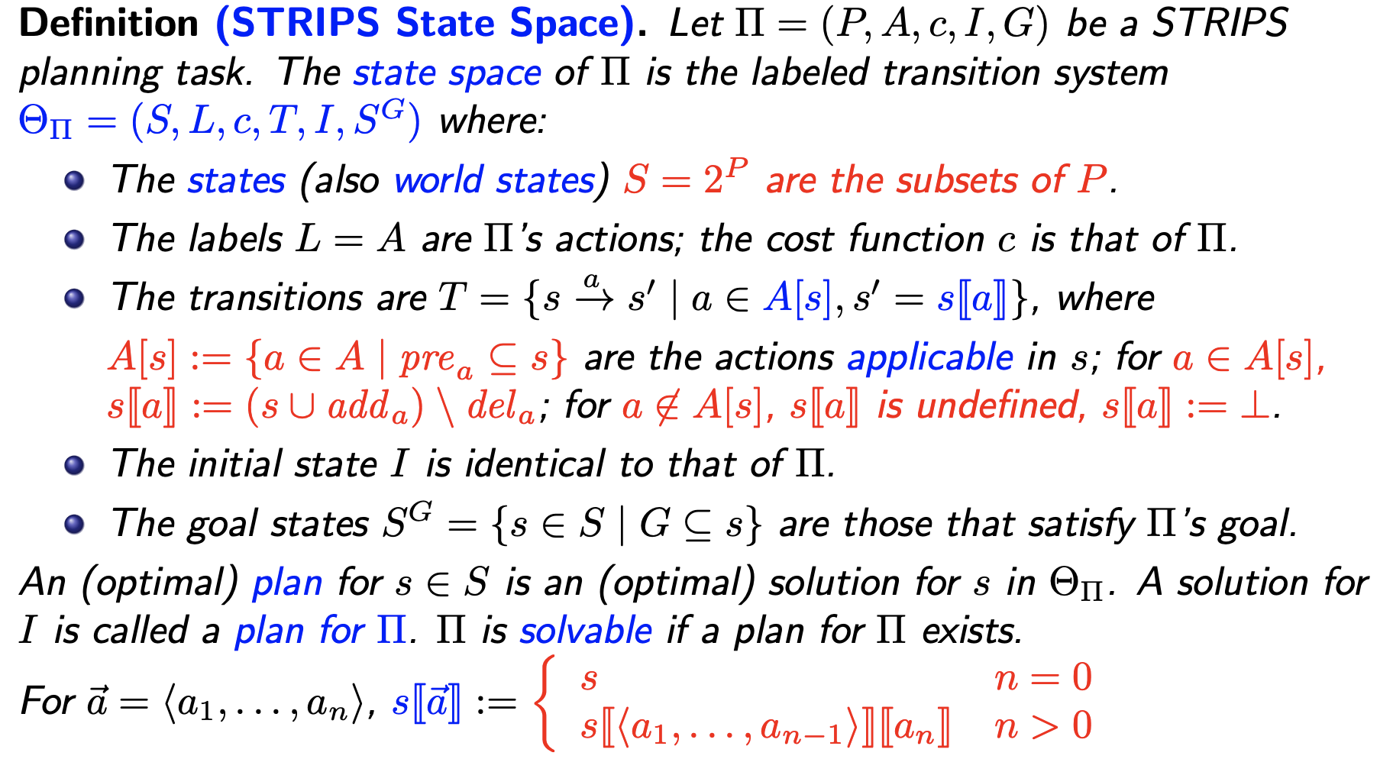
STRIPS Planning: Semantics

Slide 11
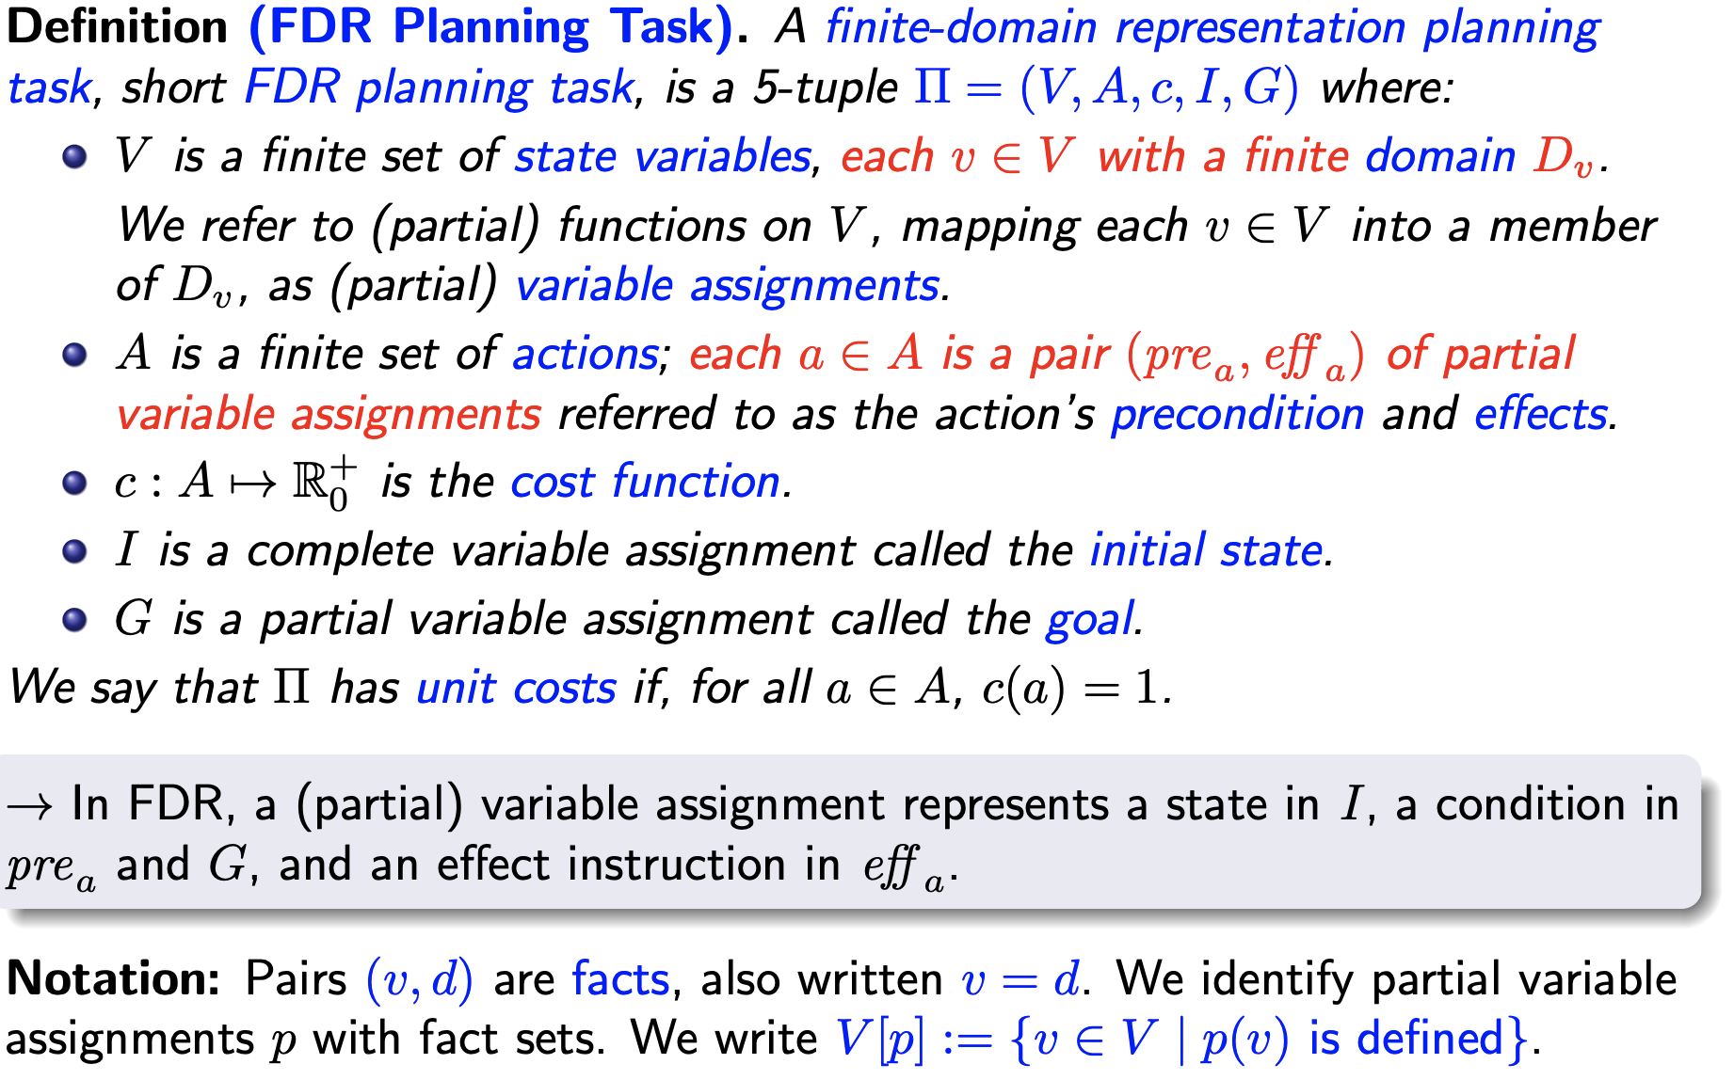
FDR Planning: Syntax

Slide 12
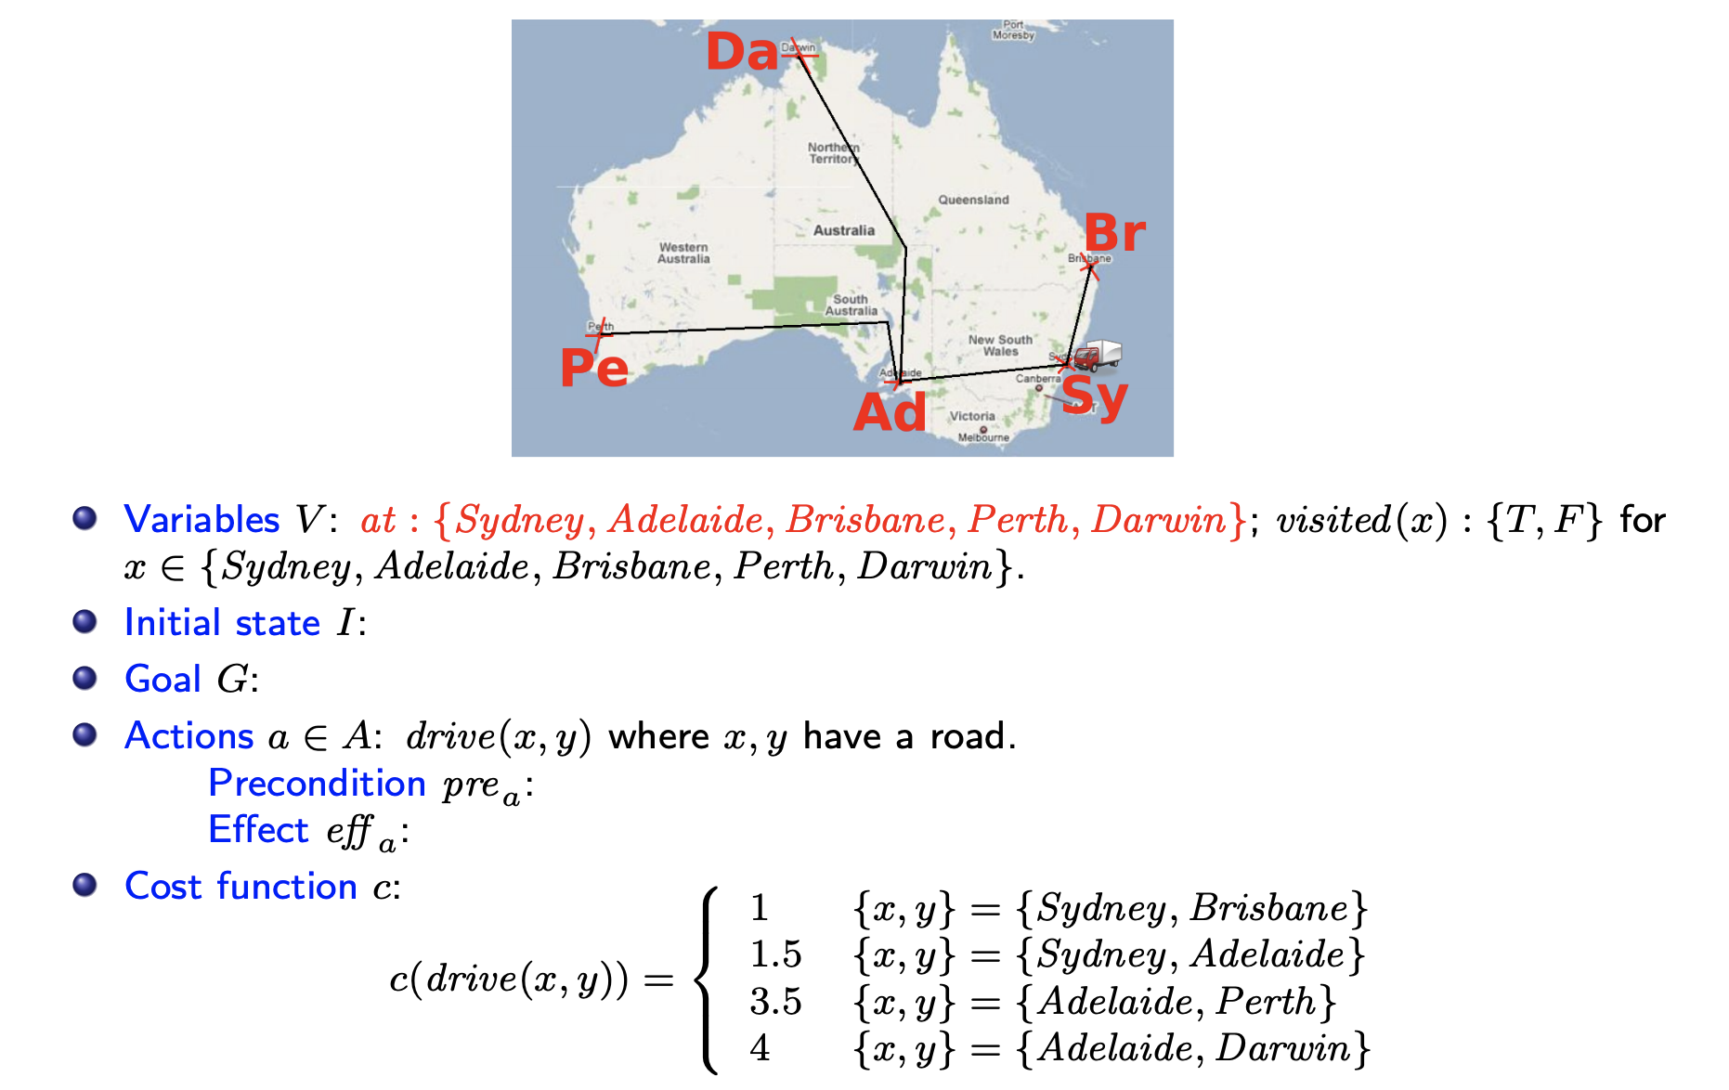
FDR Encoding of “TSP”

Slide 13
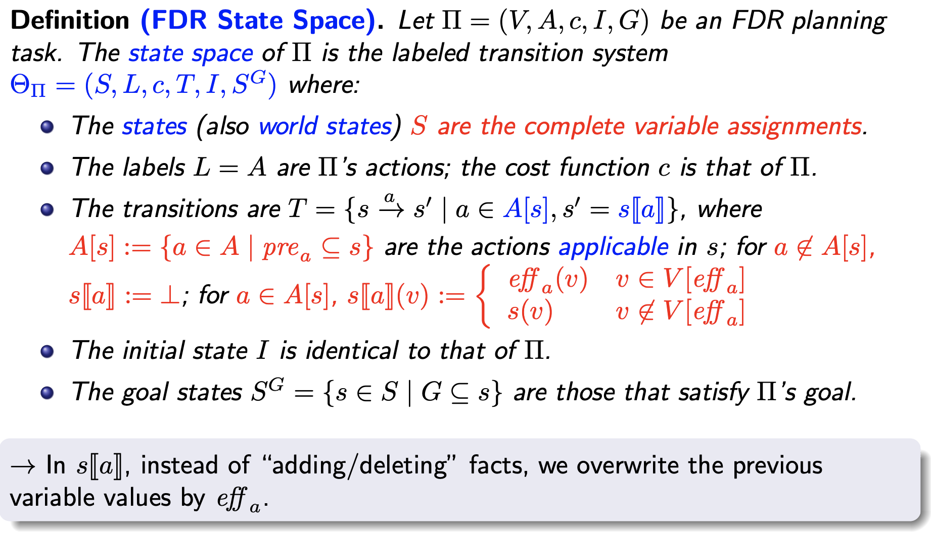
FDR Planning: Semantics

Slide 14
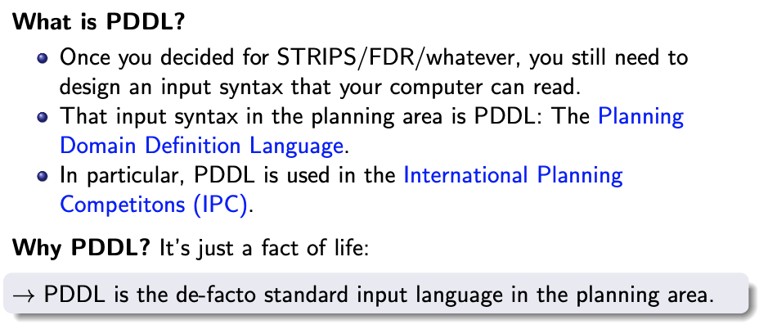
PDDL

Slide 15
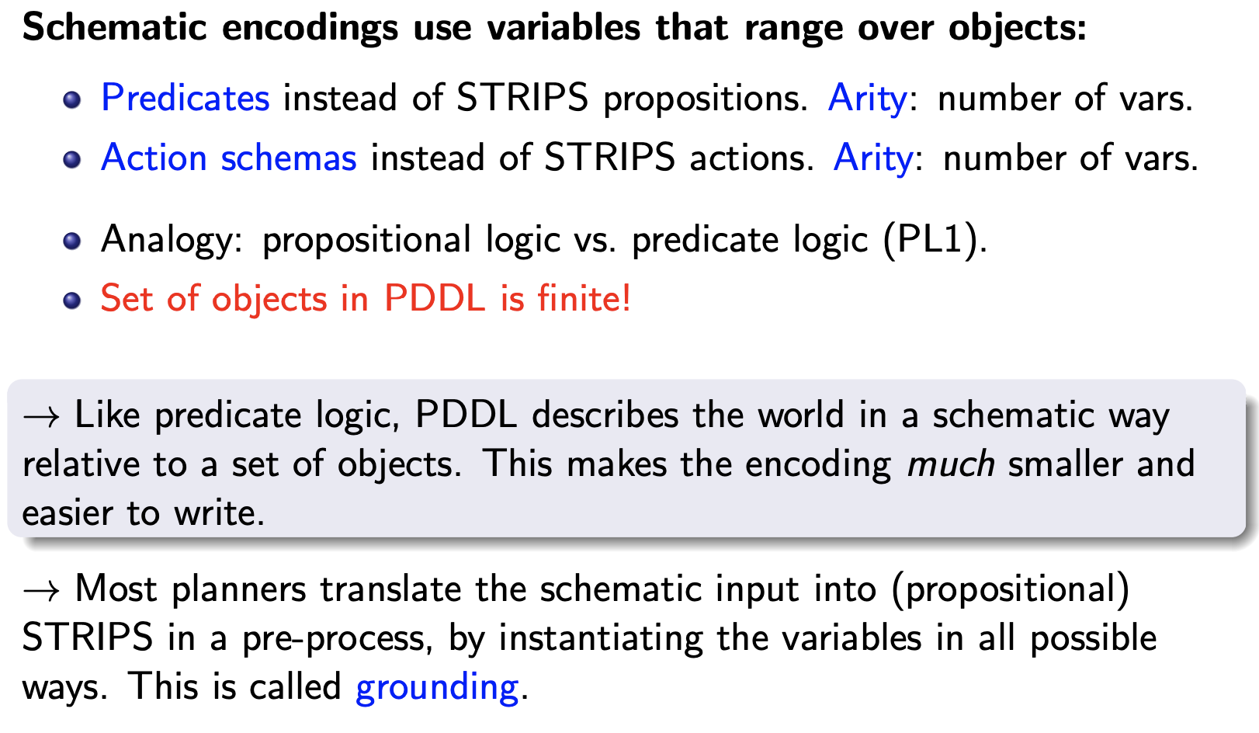
PDDL Design Principle: Schematic Encodings

Slide 16
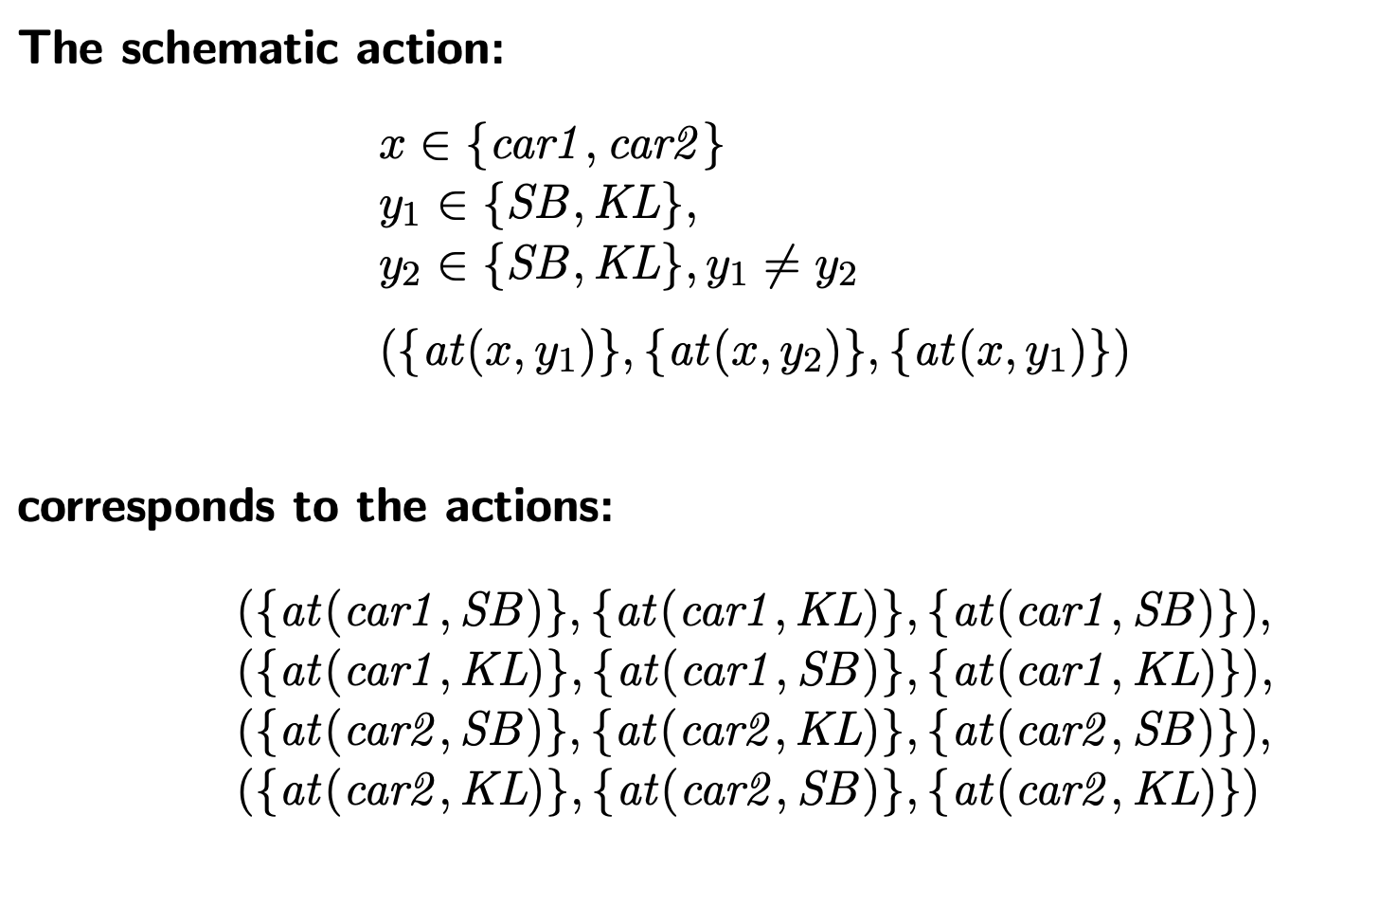
Schematic Encodings Example

Slide 17
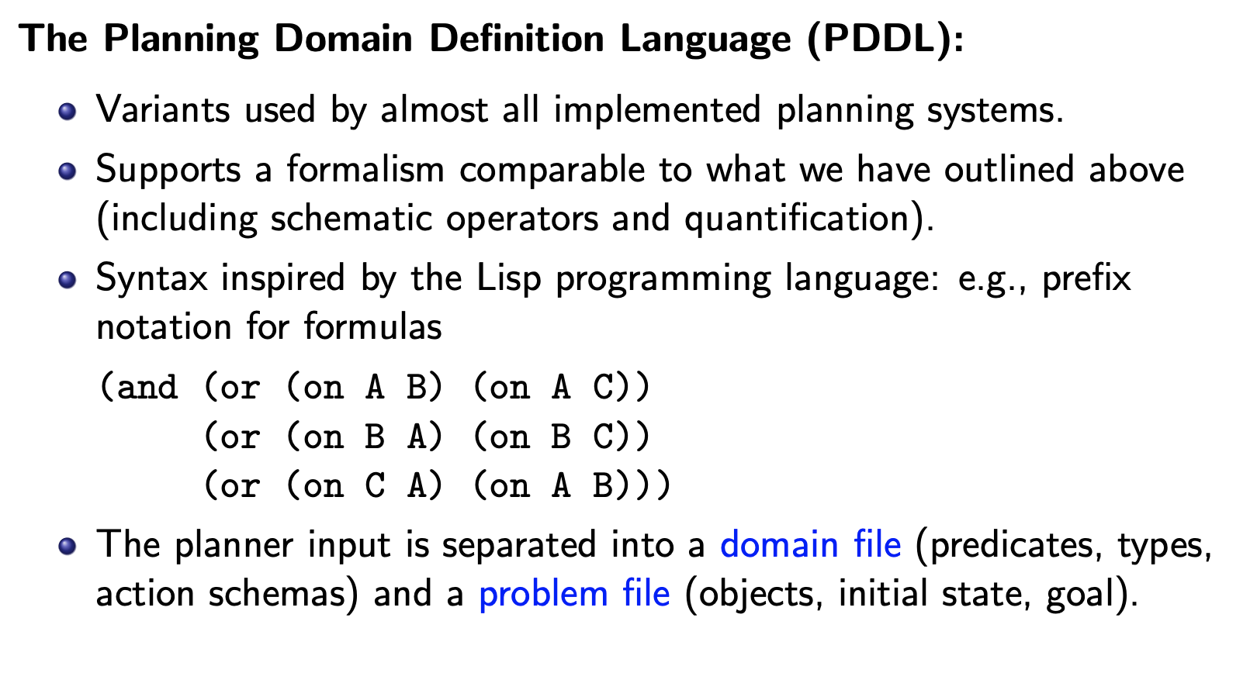
PDDL Basics

Slide 18
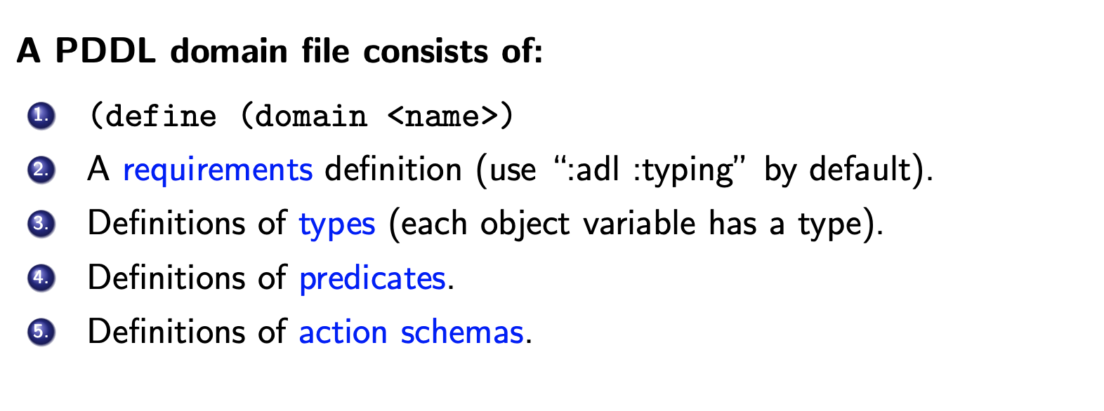
PDDL Domain Files

Slide 19
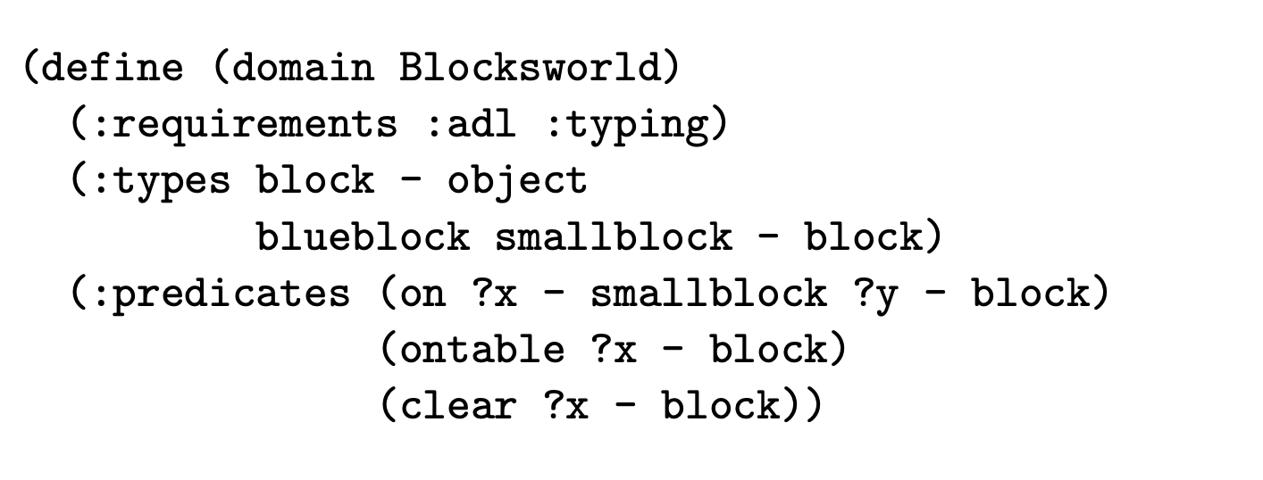
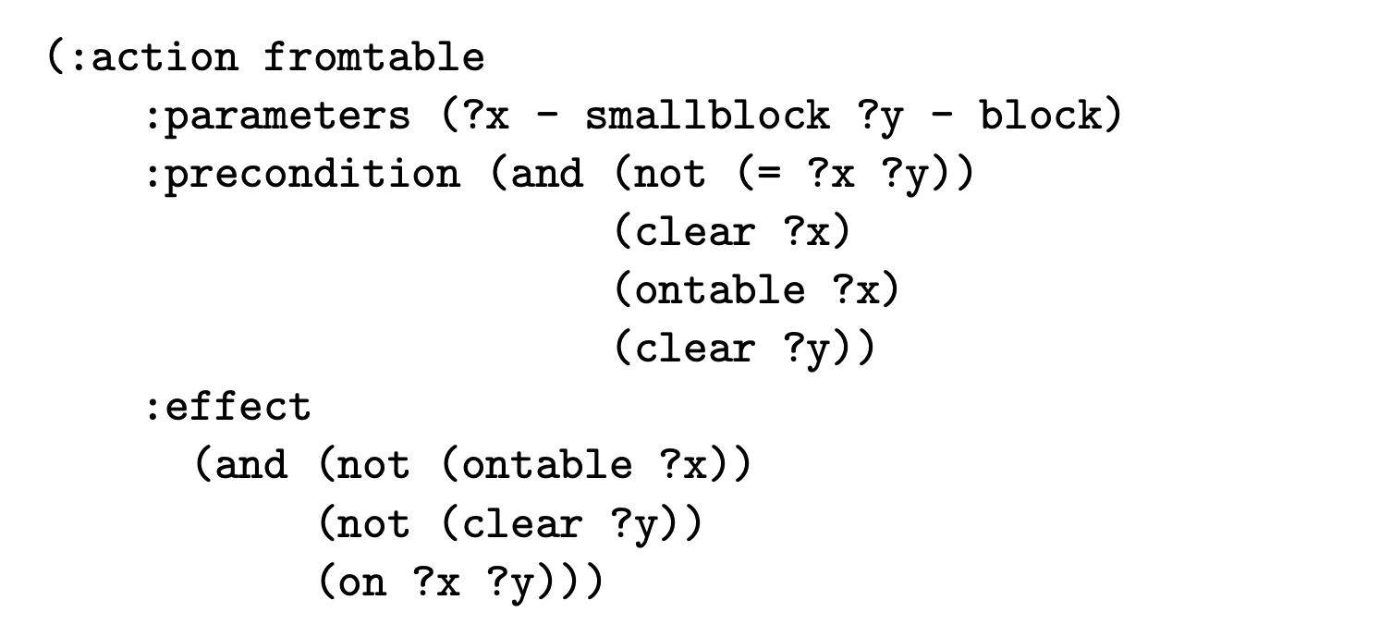
Example Blocksworld

Slide 20
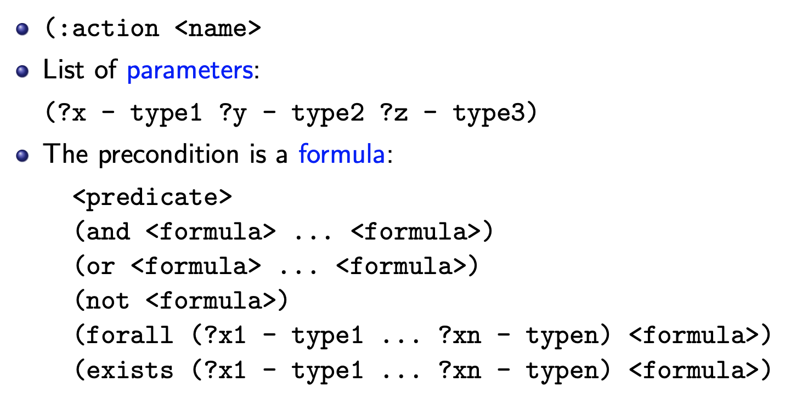
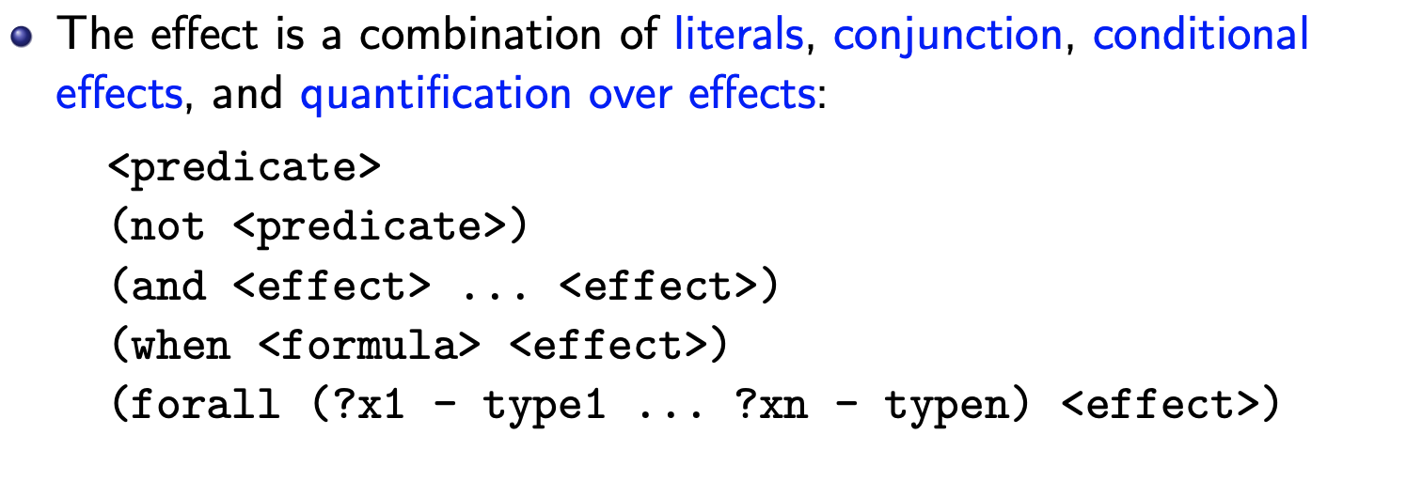
PDDL Grammar: Action Schema

Slide 21
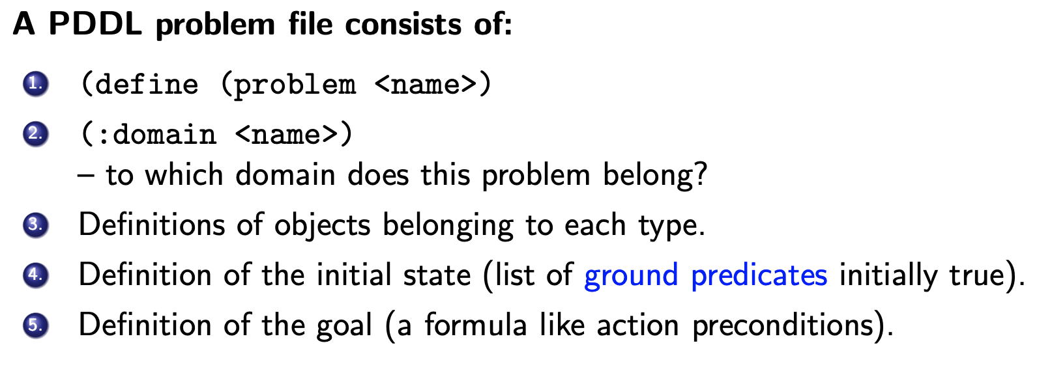
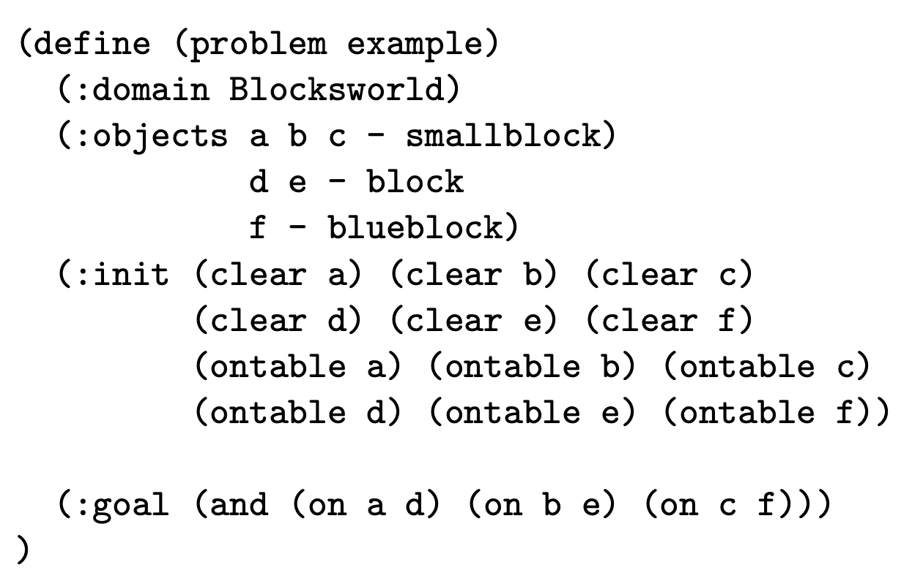
PDDL Problem Files

Slide 22
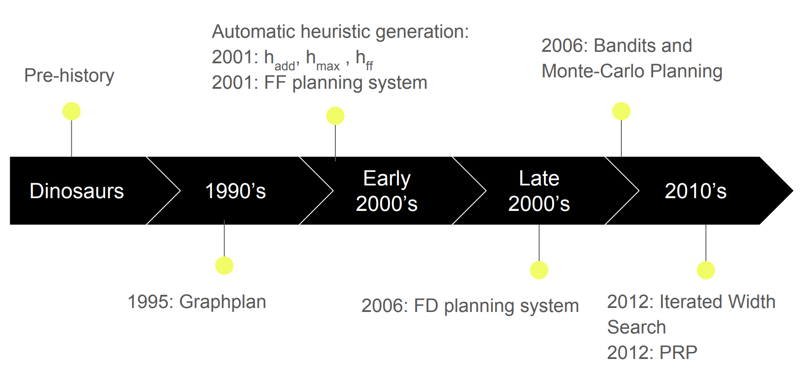
AI Planners and Tools

Slide 23
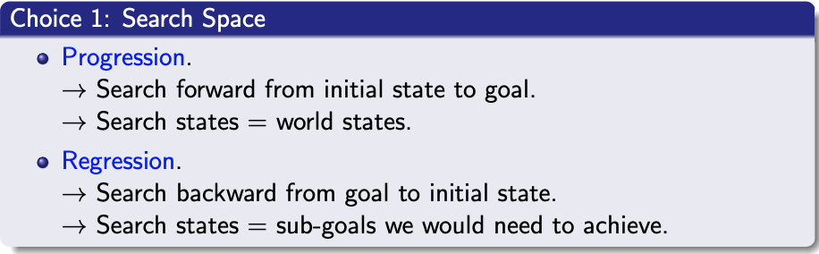
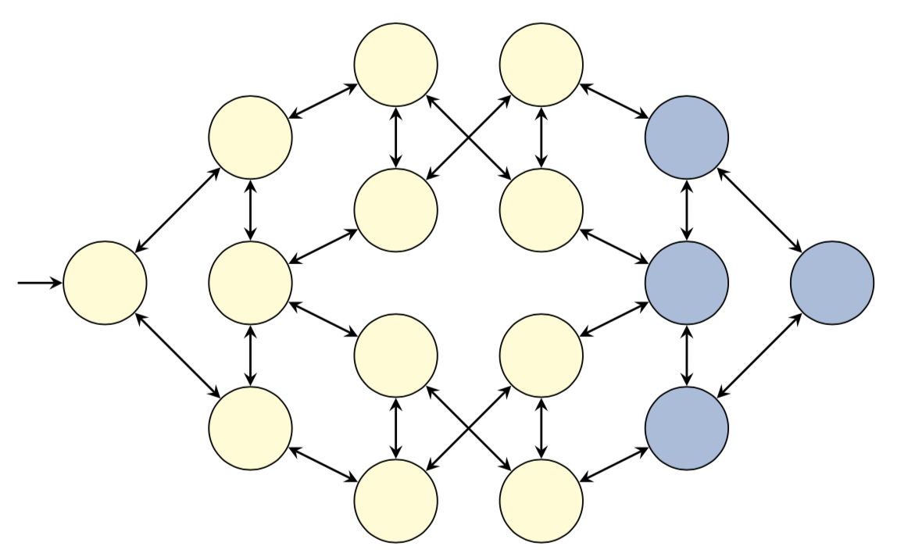
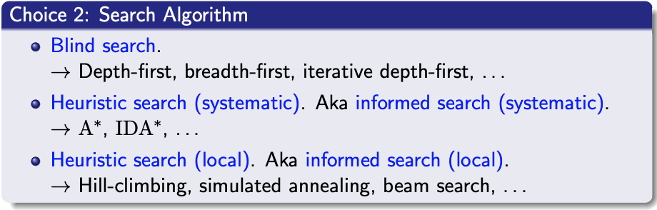
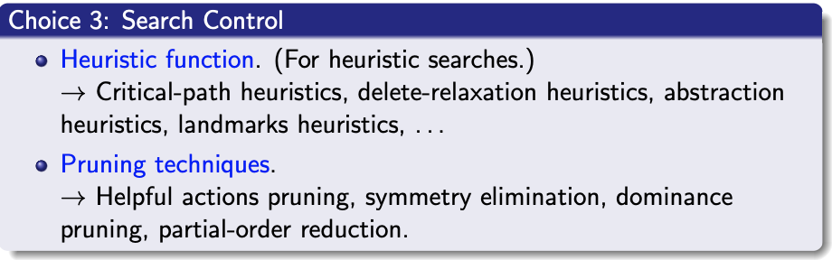
Planning as Classical Search
There are three independent choices to make:

Slide 24
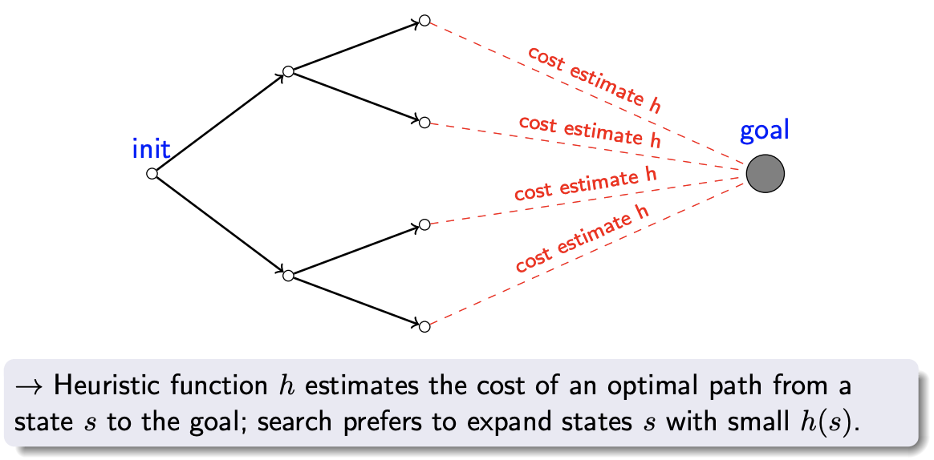
Heuristic Search
Live Demo vs. Breadth-First Search: http://qiao.github.io/PathFinding.js/visual

Slide 25
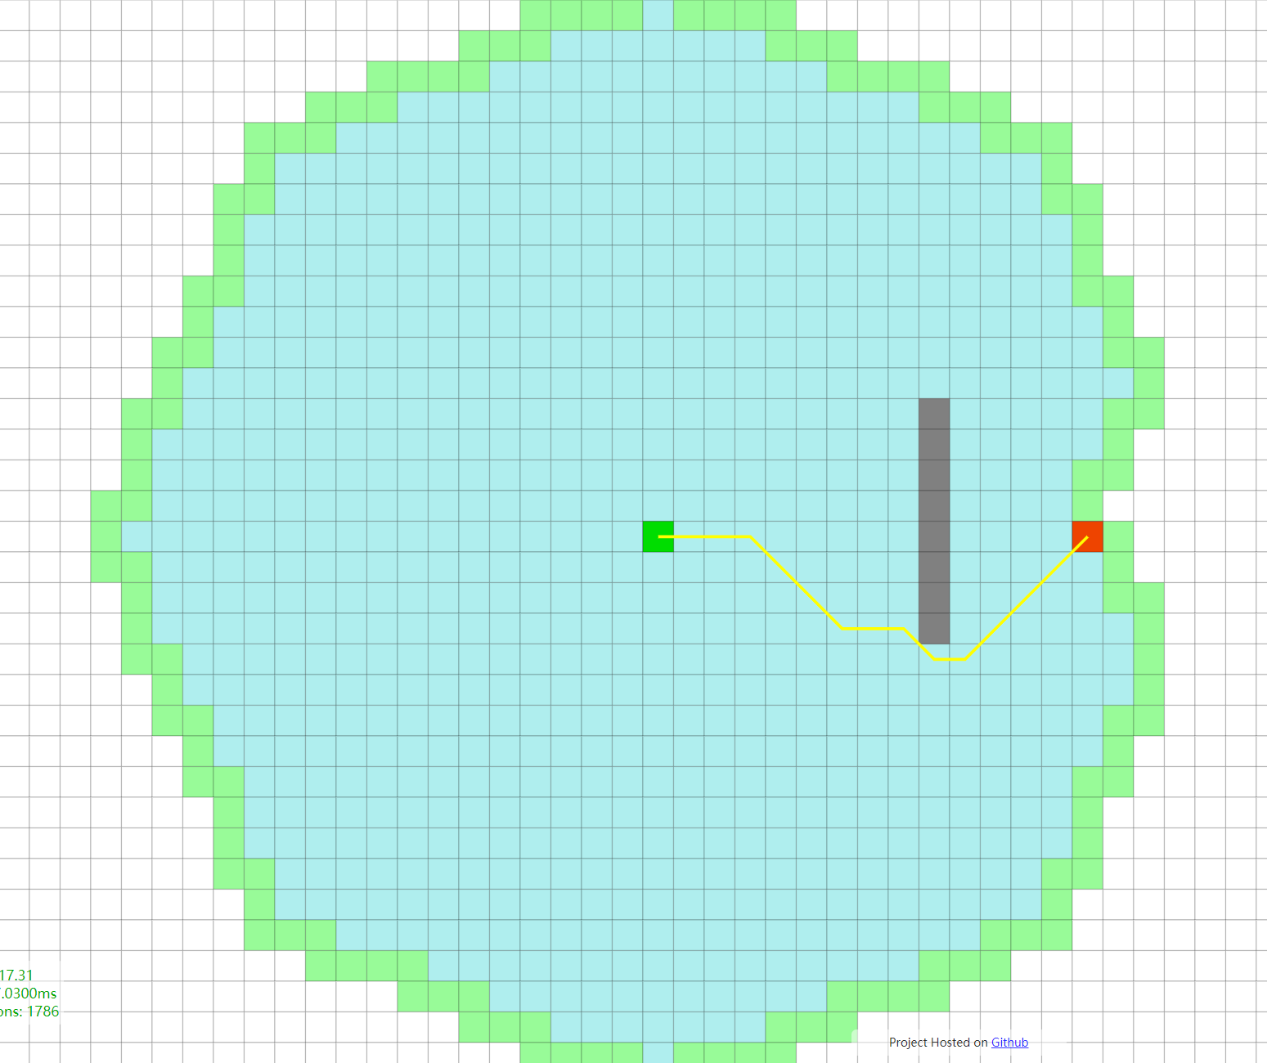
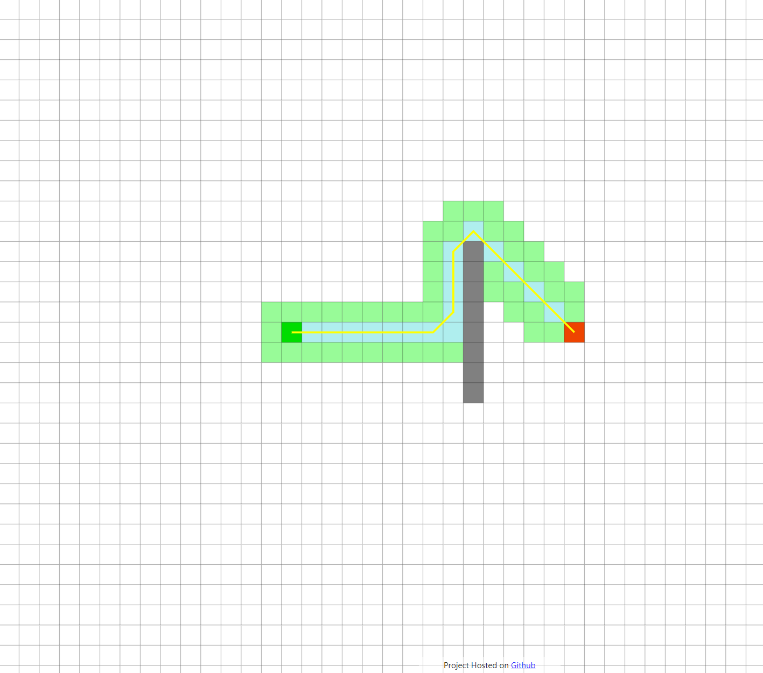
Optimal heuristic value function $h^{∗}$
Dijkstra
A*
http://qiao.github.io/PathFinding.js/visual

Slide 26
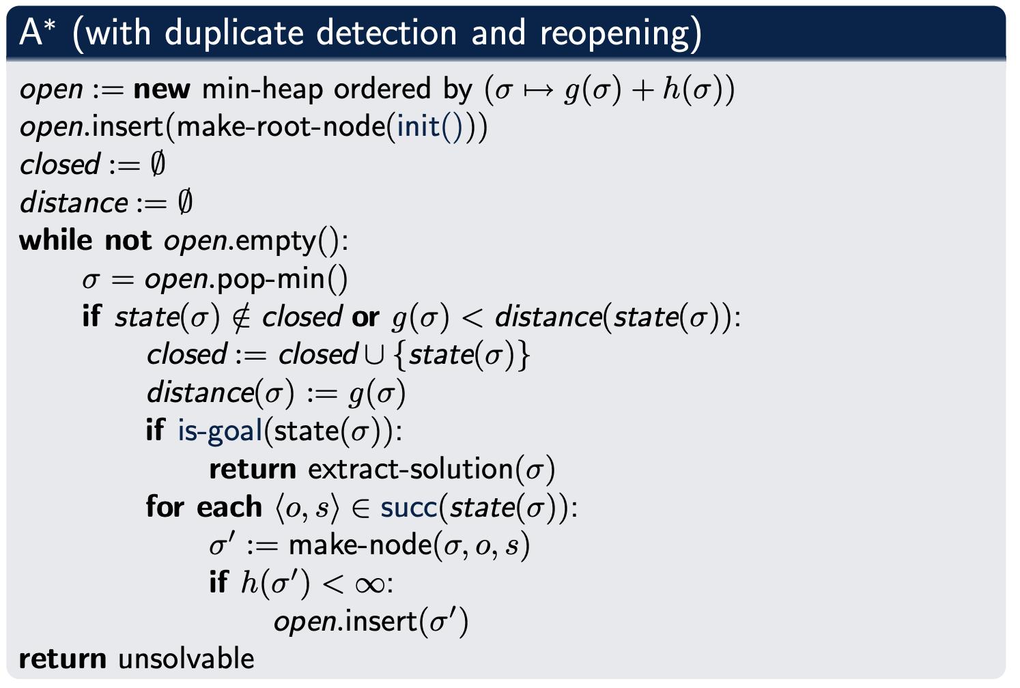
A∗ Algorithm
the most commonly used algorithm for optimal planning
rarely used for satisficing planning
optimal if h is admissible and/or consistent

Slide 27
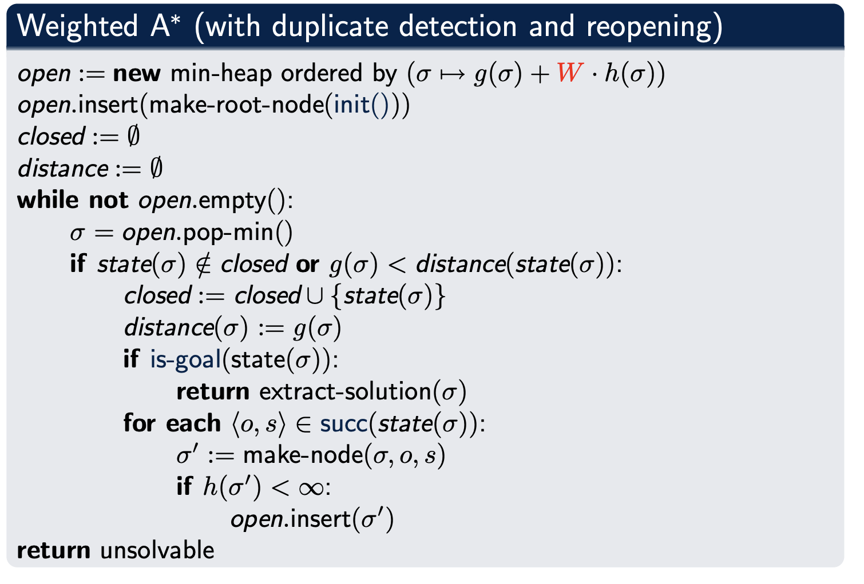
Weighted A∗ Algorithm
one of the most commonly used algorithms for satisficing planning
for W > 1, can prove similar properties to A∗ , replacing optimal with bounded suboptimal: generated solutions are at most a factor W as long as optimal ones

Slide 28
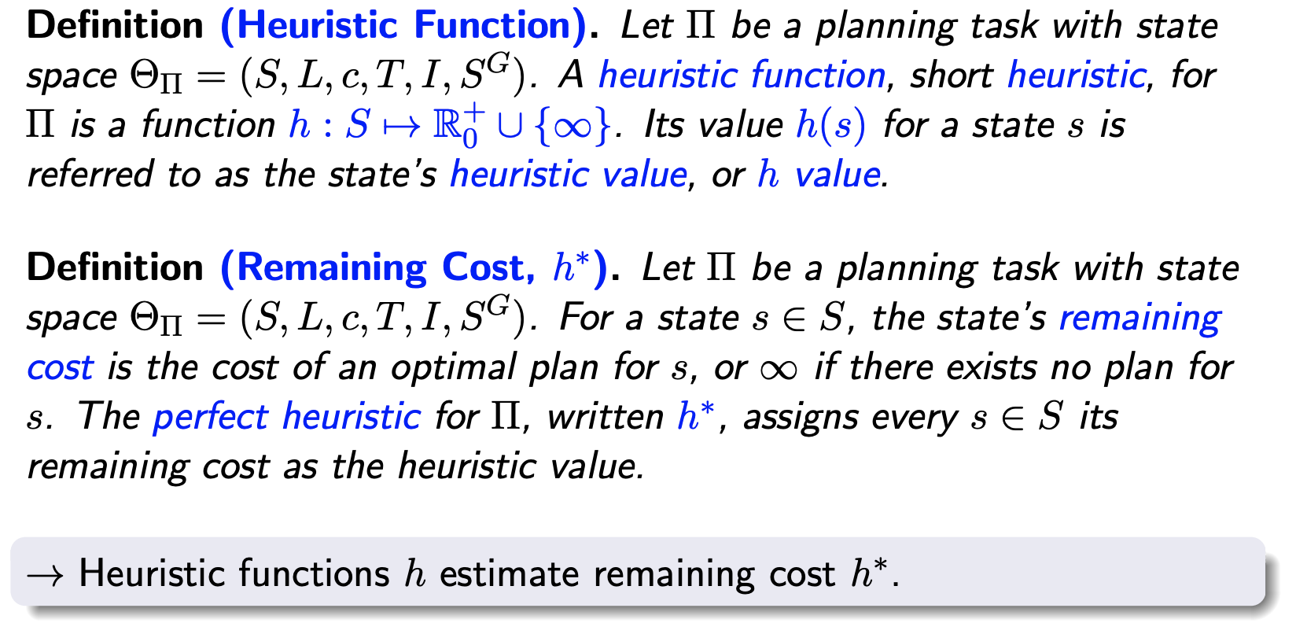
Heuristic Functions

Slide 29
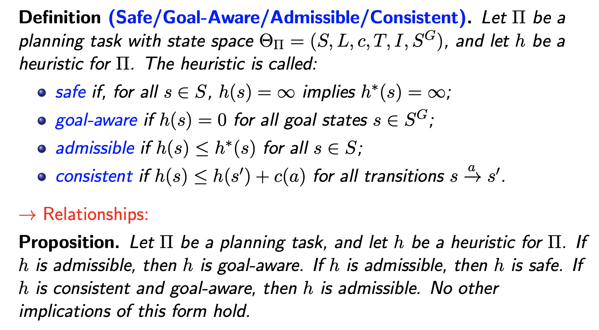
Properties of Individual Heuristic Functions

Slide 30
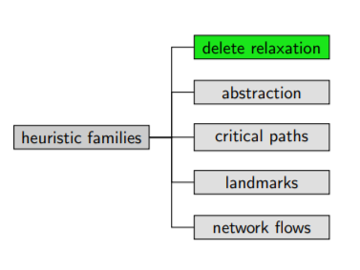
Five Families of Heuristics Value Functions
How do we come up with heuristics for general problems?
five major approaches in the literature
delete relaxation
abstraction
critical paths
landmarks
network flows

Slide 31
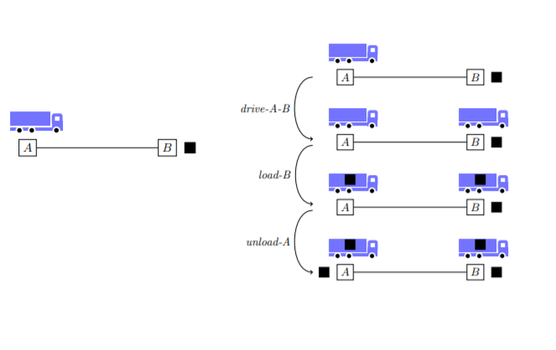
Heuristic Value Functions: Delete Relaxation
Delete Relaxation: Estimate cost to goal by considering simpler planning task without negative side effects of actions, ignore “bad effects” of actions.

Slide 32
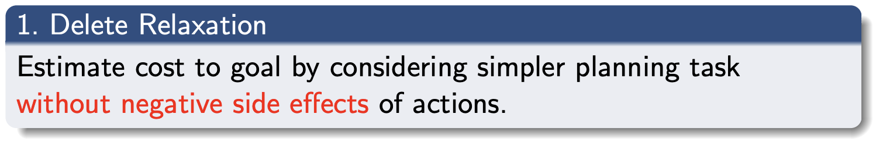
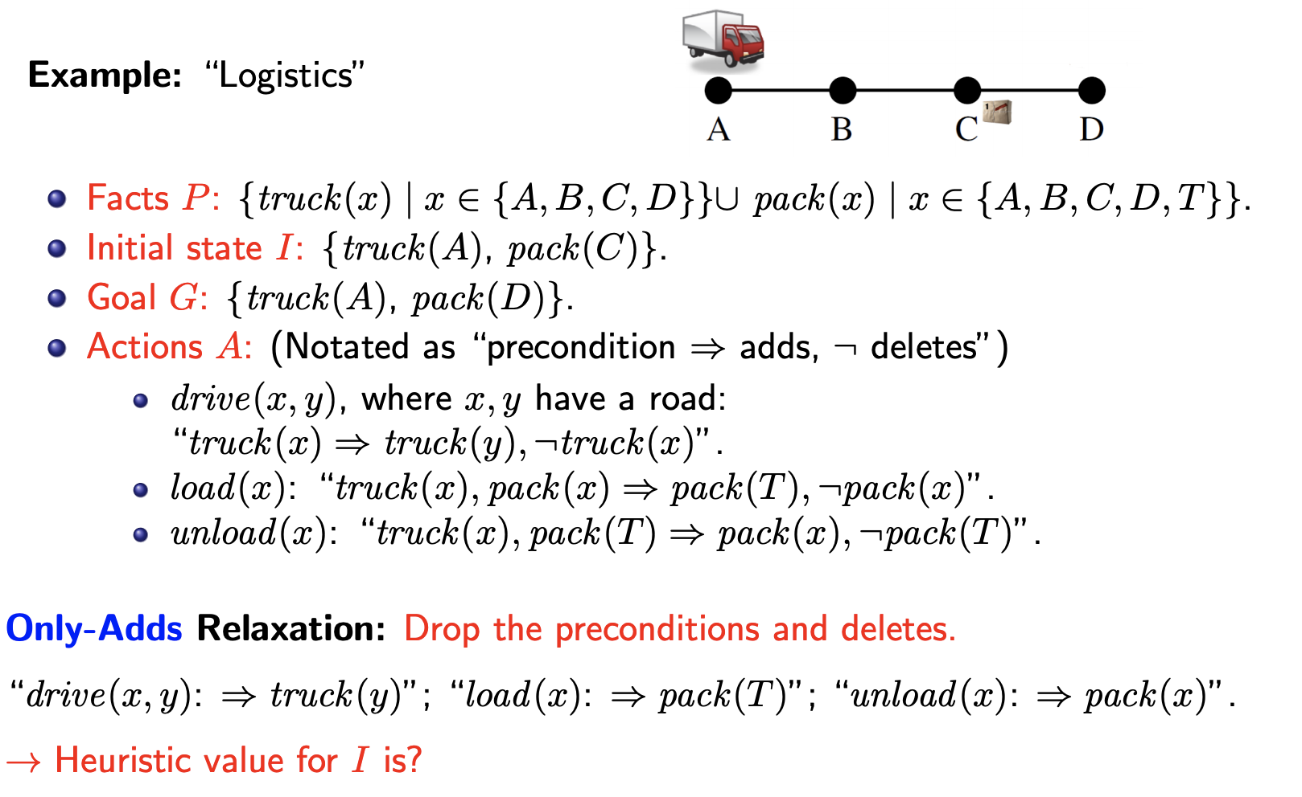
Heuristic Value Functions : Delete Relaxation

Slide 33
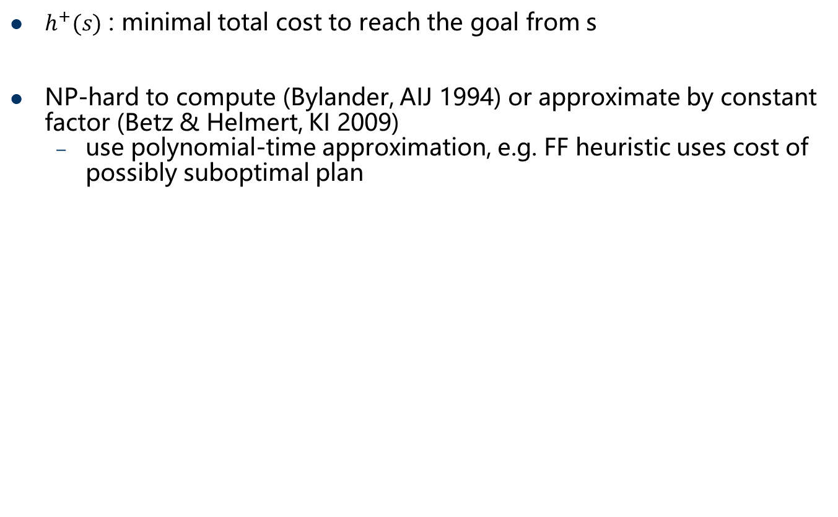
Optimal Relaxed Heuristic Value Function
$h^{+}(s)$ : minimal total cost to reach the goal from s
NP-hard to compute (Bylander, AIJ 1994) or approximate by constant factor (Betz & Helmert, KI 2009)
use polynomial-time approximation, e.g. FF heuristic uses cost of possibly suboptimal plan

Slide 34
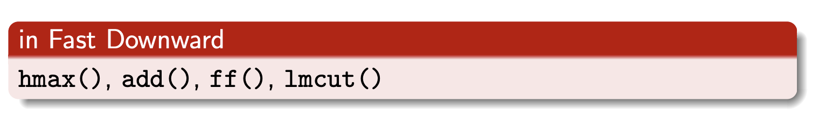
Delete Relaxation Heuristics in the Literature
Delete relaxation heuristics in the literature (admissible in red):
max heuristic (Bonet & Geffner, ECP 1999; AIJ 2001)
additive heuristic (Bonet & Geffner, ECP 1999; AIJ 2001)
FF heuristic, h + heuristic (Hoffmann & Nebel, JAIR 2001)
pairwise max heuristic (Mirkis & Domshlak, ICAPS 2007)
set-additive heuristic (Keyder & Geffner, ECAI 2008)
Steiner tree heuristic (Keyder & Geffner, IJCAI 2009)
landmark-cut heuristic (Helmert & Domshlak, ICAPS 2009)
improved LM-Cut (Bonet & Helmert, ECAI 2010)

Slide 35
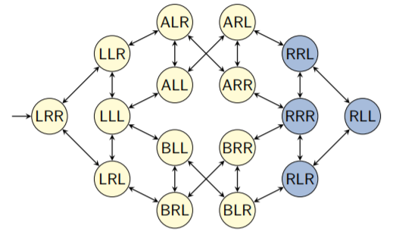
Heuristic Value Functions : Abstraction
Abstraction: Estimate cost by projecting the state space to a smaller space (applying a graph homomorphism).
orginal state space
state variable package: {L, R, A, B}
state variable truck A: {L, R}
state variable truck B: {L, R}

Slide 36
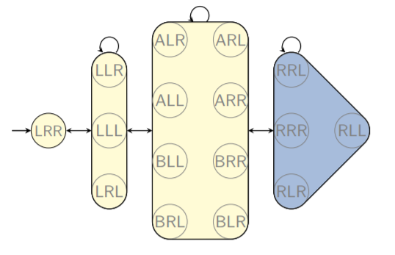
Heuristic Value Functions : Abstraction
Abstraction: Estimate cost by projecting the state space to a smaller space (applying a graph homomorphism).
abstract state space
Most edges correspond to several parallel transitions, with different labels

Slide 37
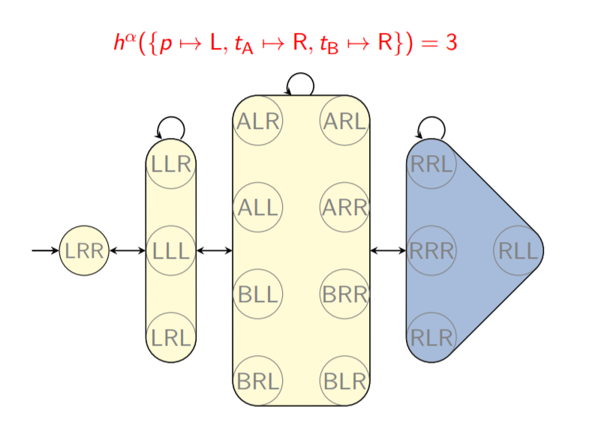
Abstraction Heuristic Value Functions

Slide 38
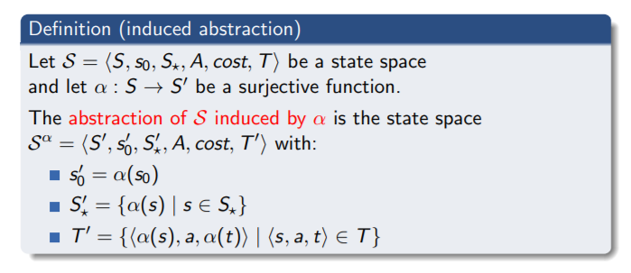
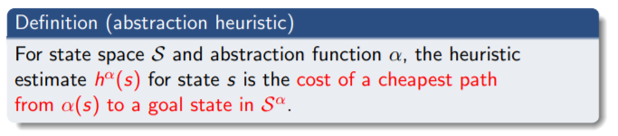
Abstraction Heuristic Value Functions
Abstract state space is derived from original state space as specified by an abstraction function
Abstraction function defines which states should be distinguished
Preserve all original paths in abstract state space
Abstraction heuristics are admissible and consistent.

Slide 39
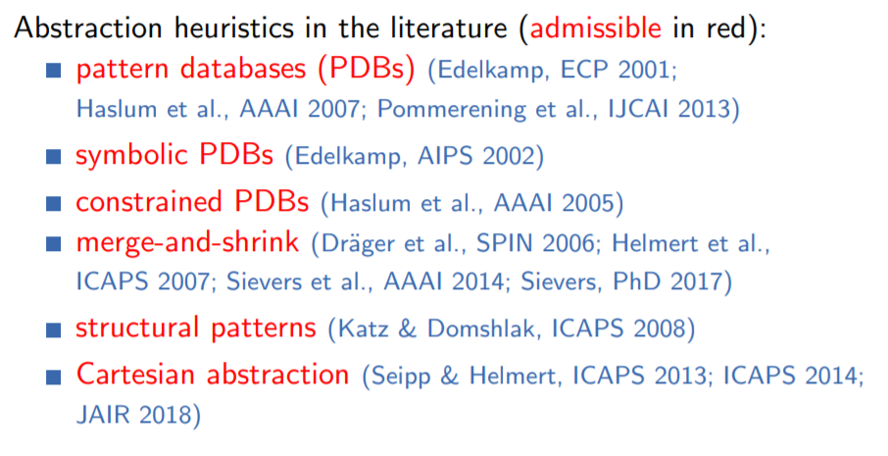
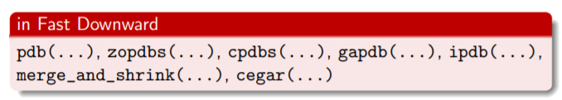
Abstraction Heuristics in the Literature

Slide 40
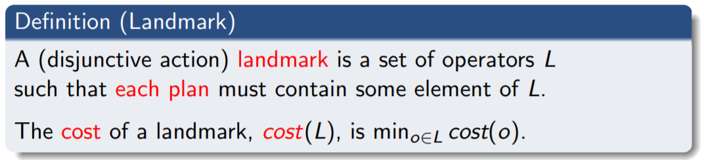
Landmarks Heuristic Value Function
Landmarks: An action set A is a landmark if all plans include an action from A.
Compute a set of landmarks and use it to derive a cost estimate
Landmark:
Action landmark
Fact Landmark

Slide 41
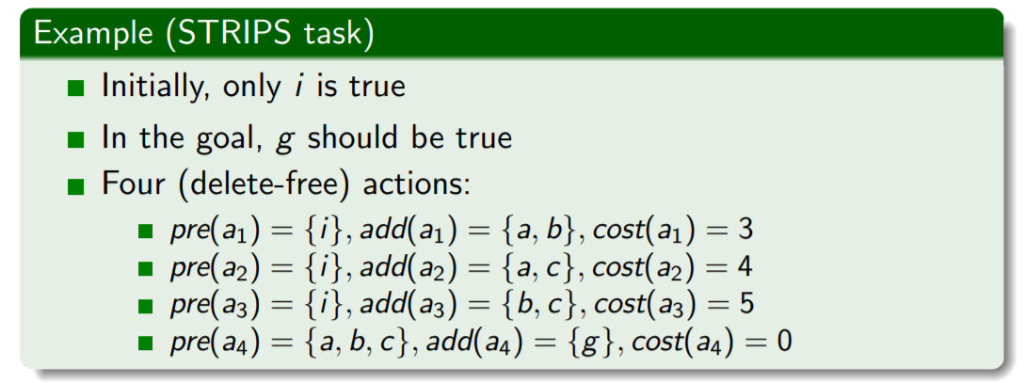
Landmarks Heuristic Value Function
Some landmarks:
W = {a4} (cost 0)
X = {a1, a2} (cost 3)
Y = {a1, a3} (cost 3)
Z = {a2, a3} (cost 4)
but also: {a1, a2, a3} (cost 3), {a1, a2, a4} (cost 0), . . .

Slide 42
Exploiting Landmarks
Assume we are given landmark set L = {W , X, Y , Z}.
How do we exploit L for heuristics?
sum of costs 0 + 3 + 3 + 4 = 10 inadmissible!
maximum of costs: max {0, 3, 3, 4} = 4 weak
best previous approach: optimal cost partitioning

Slide 43


Landmark Heuristics with Optimal Cost Partitioning
Karpas & Domshlak, IJCAI 2009

Slide 44

Landmark Heuristics with Optimal Cost Partitioning

Slide 45


对偶LP
Bonet & Helmert, ECAI 2010

Slide 46

对偶LP
Bonet & Helmert, ECAI 2010

Slide 47


Beyond Optimal Cost Partitioning
$h^{L}\left(I\right)=6$ is a good estimate, but $h^{+}\left(I\right)=7$ ! Can we do better with the same information?
Minimum hitting set: {a1, a2, a4} with cost 3 + 4 + 0 = 7

Slide 48

Landmark Heuristics in the Literature

Slide 49
Network Flows Heuristic Value Function
In every plan, the number of times each fact is produced
vs. the number of times it is consumed must be "balanced”.
Solve a linear program encoding this information.
One package, two trucks, two locations
Variables describe positions of trucks and packages
Package initially at location 1 and trucks at location 2
Goal: package at location 2, truck 1 at location 1

Slide 50

Network Flow Heuristics in the Literature

Slide 51
Summary
Classical planning
PDDL language
Heuristic search
Heuristic functions

